Slide 1
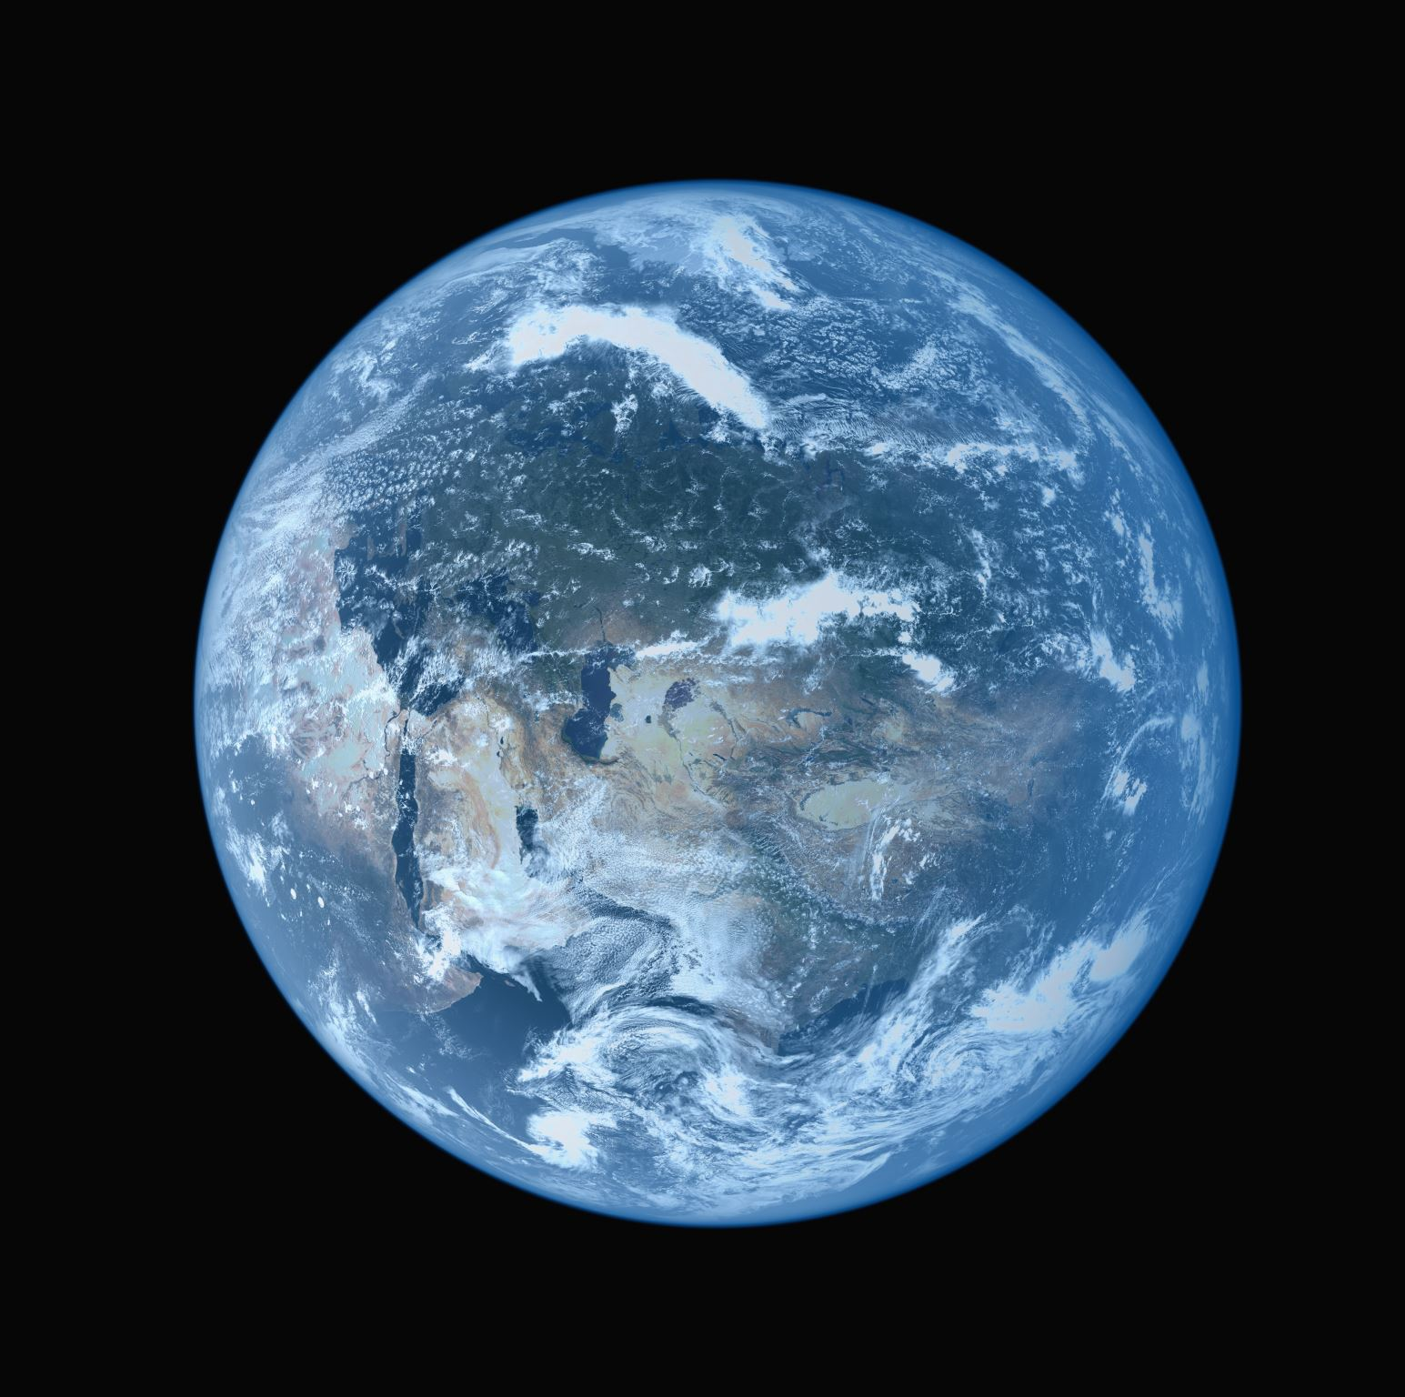
Earth
Chapter 5
Lesson 1
Pages 104-109

Slide 2
Chalk talk
Let's write down what we know about the earth.
Something you have already learned in another class, at home or something you have observed.
One-two sentences.
Be prepared to share with the class.

Slide 3
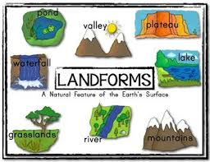
Landform
A physical feature of the land is called a landform.
Landforms are different shapes of the earths surface.

Slide 4
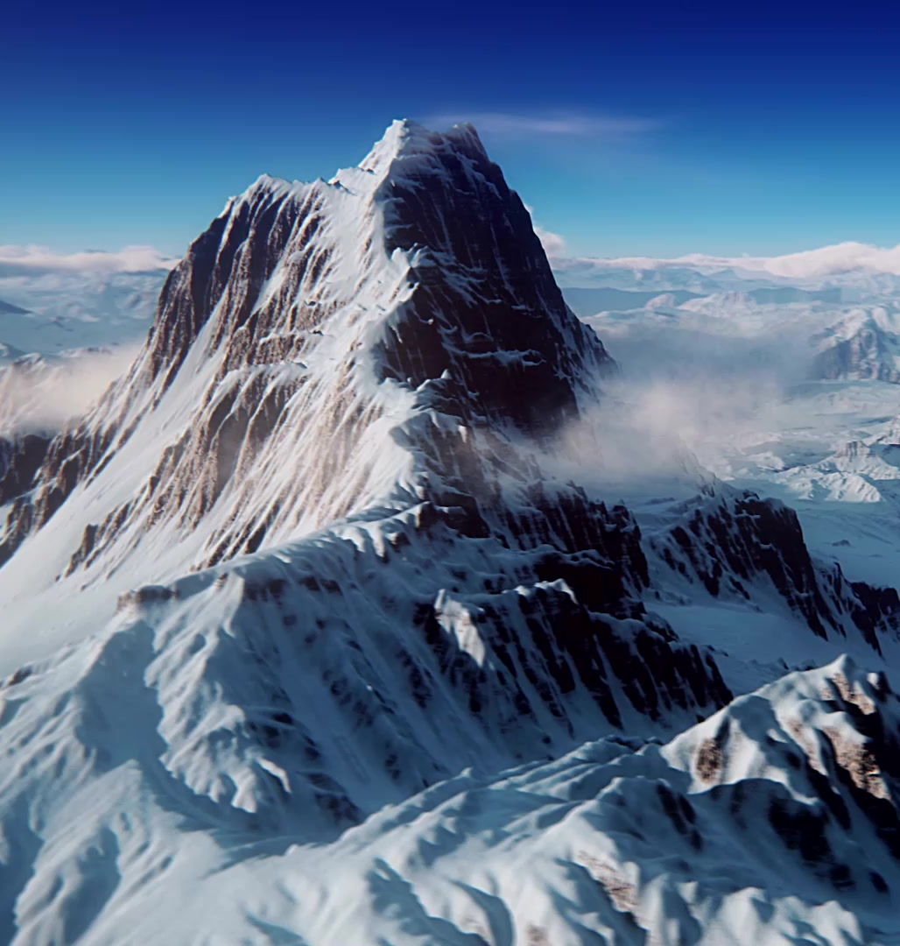
Mountains
The tallest of all landforms are mountains.
Mountains are a landform that rises above its surroundings.

Slide 5
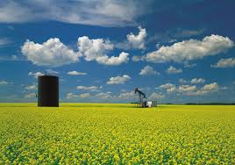
Plains
Vast areas of land without mountains or hills are called plains.
Large flat land with little to no trees.

Slide 6
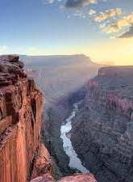
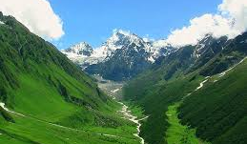
Water
Water shapes valleys and canyons into landforms.

Slide 7
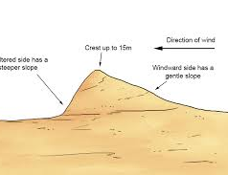
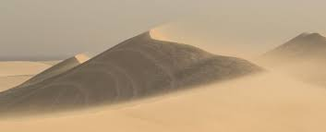
SAND DUNES
Mounds, called sand dunes, form where wind blows sand.

Slide 8
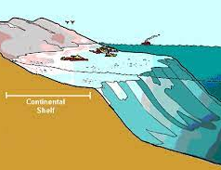
Continental shelf
The gently sloping edge of a continent that connects the shore to the sea is a continental shelf.

Slide 9
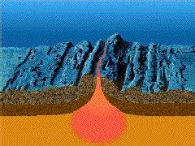
Ocean ridge
Underwater mountains that run through the ocean form an ocean ridge.
Seafloor mountain.

Slide 10
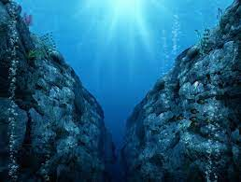
Trenches
Features that look like canyons in the ocean floor are called trenches

Slide 11
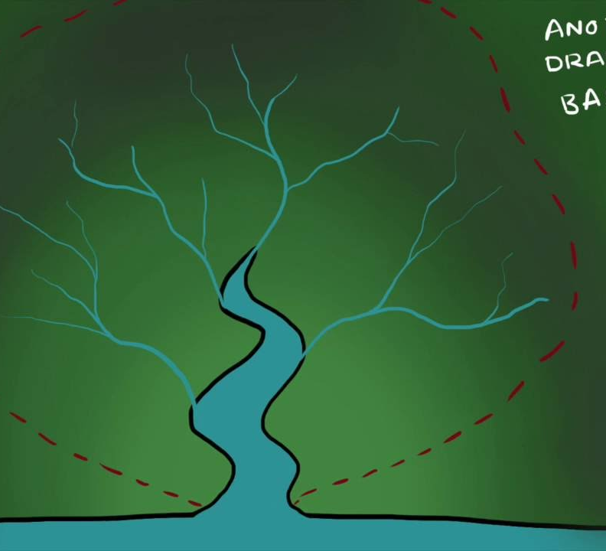
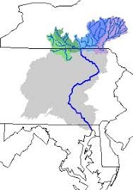
Drainage Basin
Regions of land where water drains into a river is a drainage basin.
We live in the Susquehanna river drainage basin!!!!

Slide 12
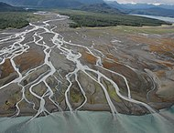
Delta
The movement of a river slows down as it nears the ocean, dropping deposits that form a triangle-shaped landform called deltas.
This is a wetland that forms when rivers empty their water.

Slide 13
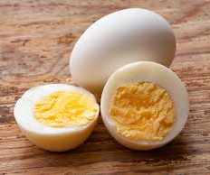
Stop, think and record
Think about a hard-boiled egg.
-Describe what its like.
What it looks like?
What it feels like?

Slide 14
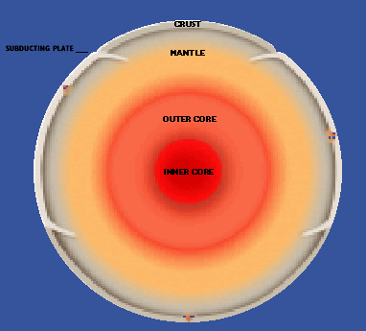
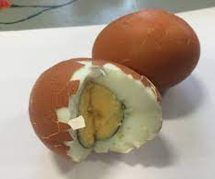
4 main layers
Scientists have divided the interior of the earth into four main layers.
Crust
Mantle
Outer core
Inner Core

Slide 15
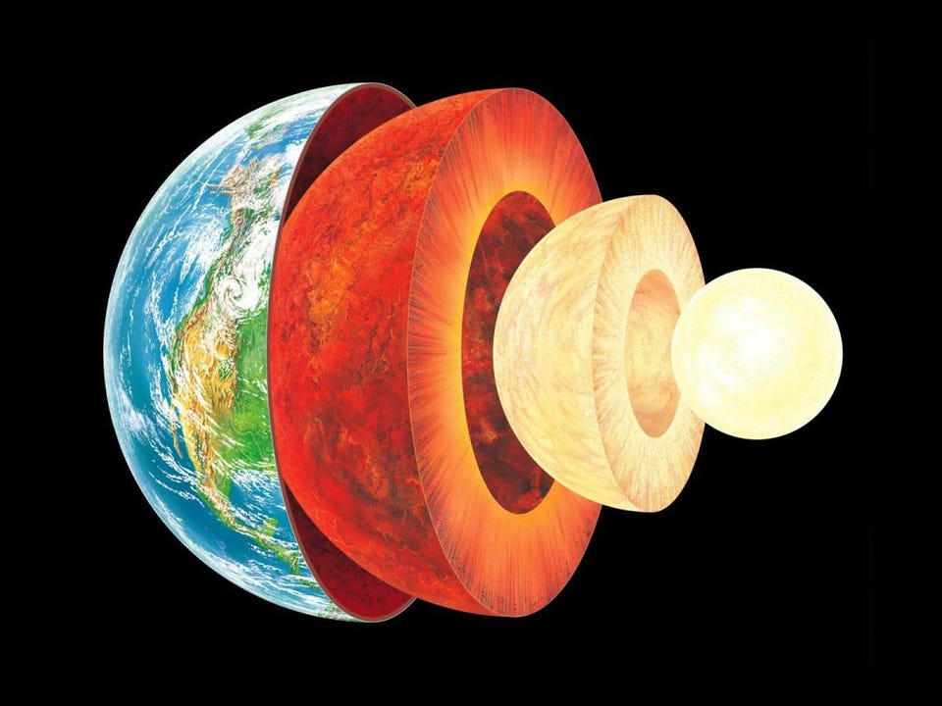
Crust
The outermost layer of earth is made up of rock, called the crust.
Crust

Slide 16
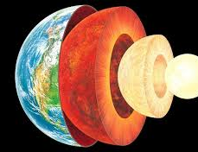
Mantle
Below the crust lies a layer of rock, called the mantle.
Its about 1,802 miles thick and super heated.
Mantle

Slide 17
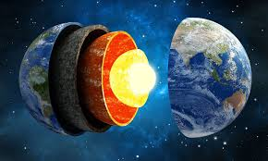
Outer core
The outer core is below the mantle and is made mostly of melted iron and nickel.
Its so hot in the outer core that its between 8,132-9,932 degrees Fahrenheit.
Outer Core

Slide 18
Inner core
The sphere of solid material at earths center is called the inner core.
Its almost the size of the moon.
Inner Core

Slide 19
Exit Questions
What landform do you live in?
What formed your landform?
Answer both questions and be prepared to share with the class or peers.

Slide 20
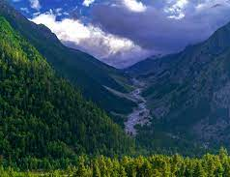
Hint!!!
This is a picture of the landform we live in.

Slide 21
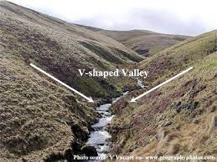
Sharing with class
We live in a valley which is a landform!!
Water is what shapes a valley by downcutting and eroding away rock.

